Slide 1

Hybrid POM/LFM Design Paradigm for UI Automation
The Automagical Marvel

Slide 2
Defining the Paradigm
What is POM and LFM?

Slide 3
Logical Function Model (LFM)
Definition: A collection of functions used to produce logical results.
Also called Functional Programming.
Design consists of functions to perform actions on the page.
Each function calls elements individually resulting in multiple references to elements.
Functions can represent entire page interactions or parts of a page.
Requires in depth knowledge of UI Automation engine (Selenium, XCUI, others)

Slide 4
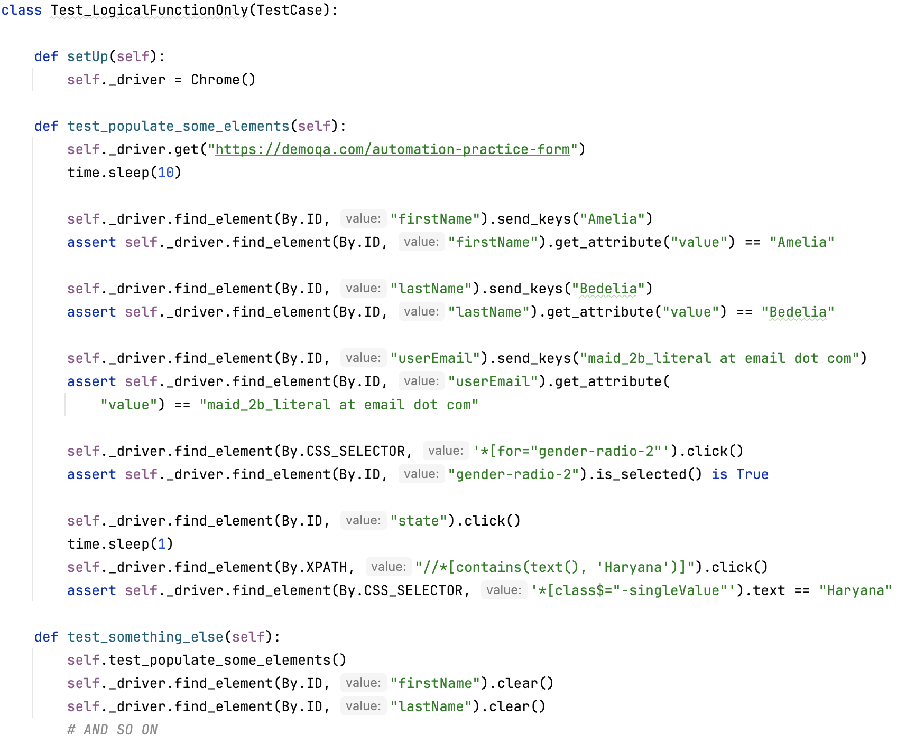
Logical Function Test
Multiple references to the same elements
Many, many places to update!
Low readability
Tests calling tests to do same actions.
Sleep padding out test runtime.

Slide 5
Page Object Model (POM)
An object-oriented class that serves as an interface to a page of your AUT.
Design consists of object models that represent pages/panes/sheets/etc.
Each page object has properties or functions used to interact with UI elements.
Pages may have additional functions built to help make interactions easier.
Robust but requires in depth knowledge of UI Automation engine (Selenium, XCUI, others)
Update once, fix everywhere design philosophy.
Notes:
According to Selenium’s own documentation
Within your web app’s UI, there are areas where your tests interact with. A Page Object only models these as objects within the test code. This reduces the amount of duplicated code and means that if the UI changes, the fix needs only to be applied in one place.
Page Object is a Design Pattern that has become popular in test automation for enhancing test maintenance and reducing code duplication. A page object is an object-oriented class that serves as an interface to a page of your AUT. The tests then use the methods of this page object class whenever they need to interact with the UI of that page. The benefit is that if the UI changes for the page, the tests themselves don’t need to change, only the code within the page object needs to change. Subsequently, all changes to support that new UI are located in one place.

Slide 6
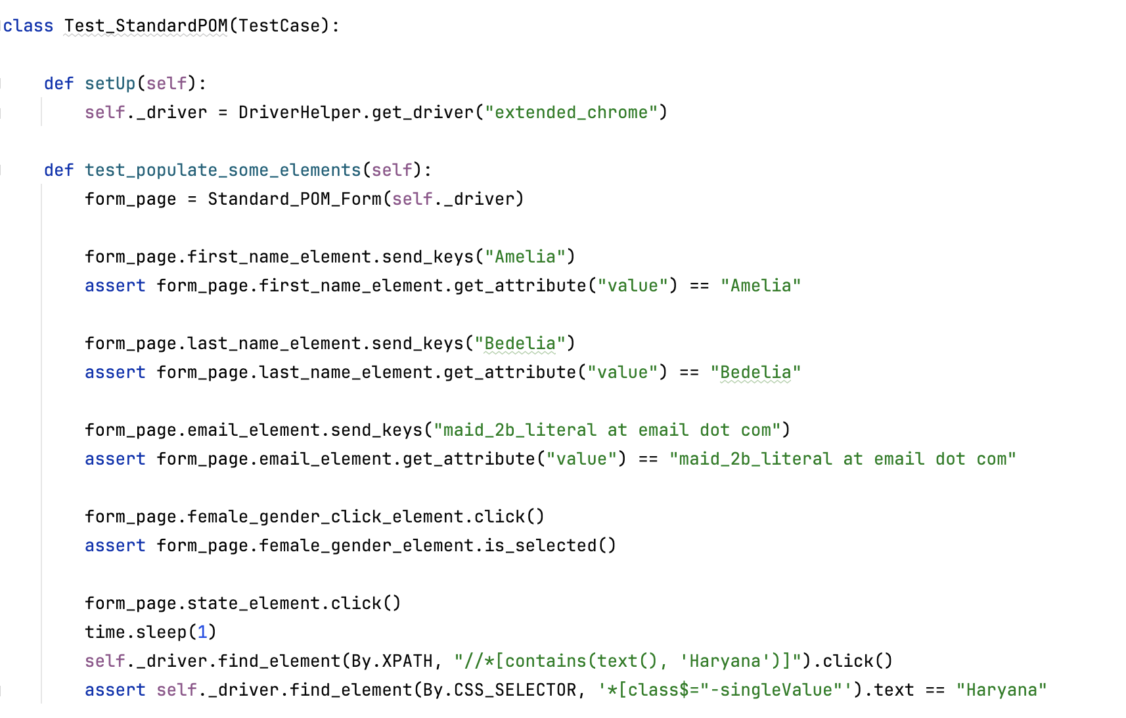
Page Object Model Test
Update once, fix everywhere
Simple to read and understand
Requires knowledge of UI Automation Library
Sometimes you might need to work with driver and elements directly.
Functional but flawed

Slide 7
Hybrid POM/LFM
Where the Line Between UI Elements and Data Types Blurs

Slide 8
Consider the Following: What is a Textbox?

Slide 9
Unifying Page Objects and Logical Functions
Provides object-oriented design of POM with the benefit of Logical Function wrappers
Developer friendly UI Automation Framework
Interacting with UI Elements is as simple as working with common data types
Booleans, Strings, Date/Time objects, Integers, Arrays, Enums, Dictionaries, etc.
Reduced effort needed to learn UI automation engine; developers focus on writing tests.
Enables in-sprint automation
Reduced maintenance costs in time/effort. (1 to 3 story points vs 8 to 13)

Slide 10
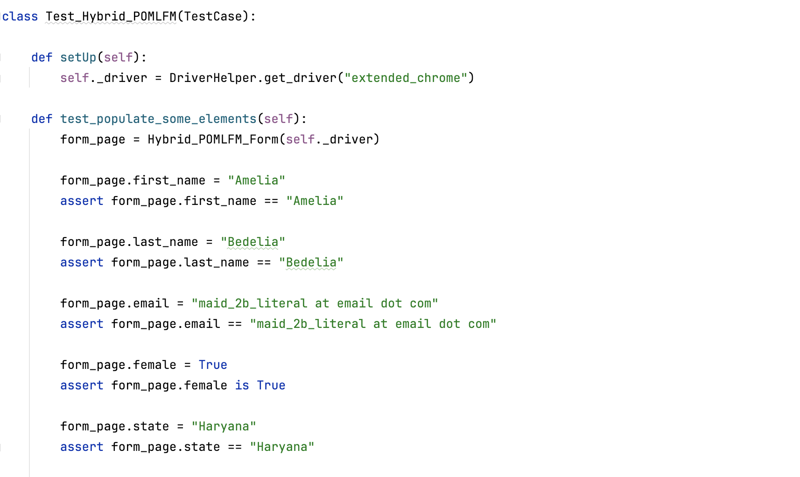
Hybrid POM/LFM Test
Easy to read and maintain
What driver? What web element?
Uses basic, native Data Types
Still Selenium under the hood
Values evaluated in real time
Some Drawbacks
Framework complexity
Up front dev time.

Slide 11
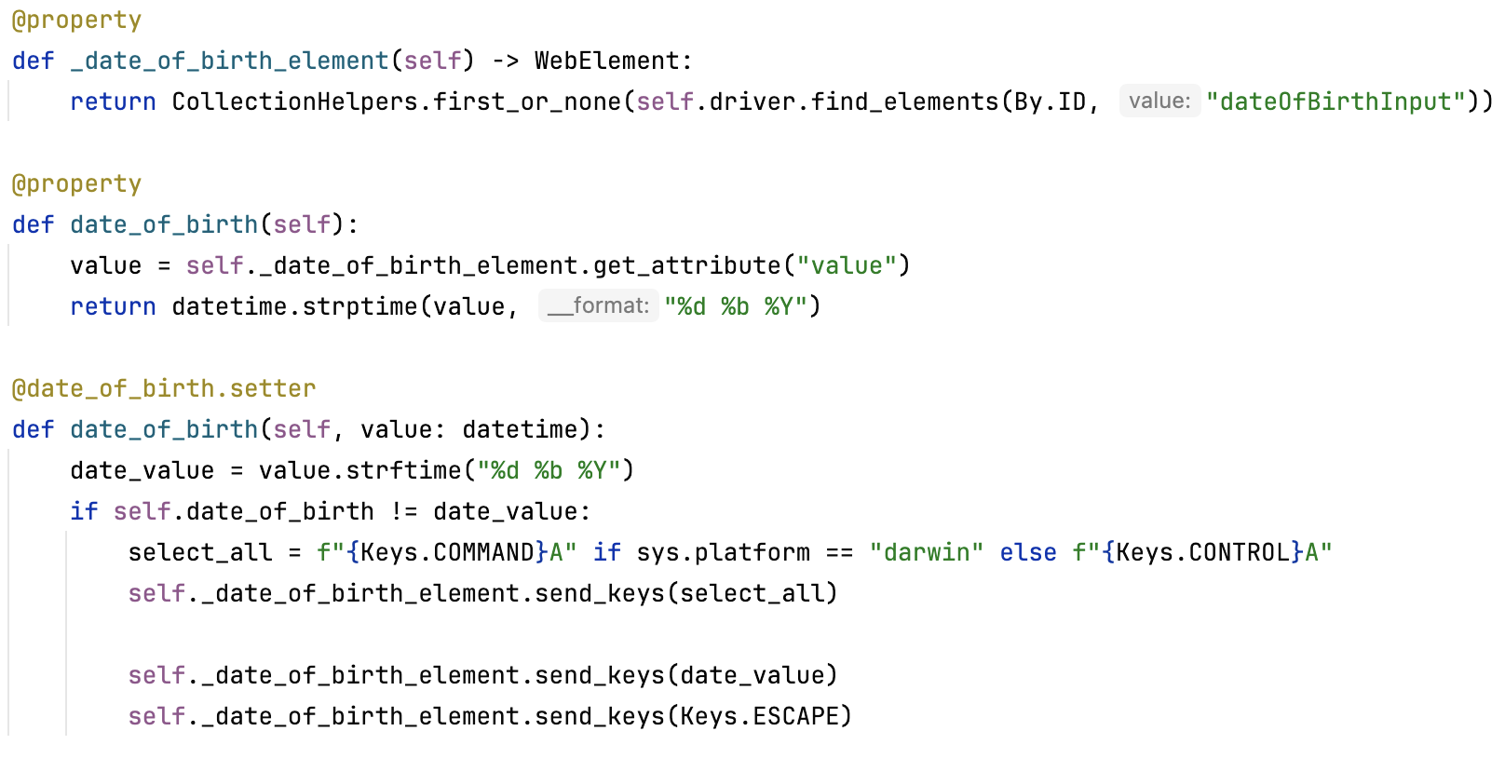
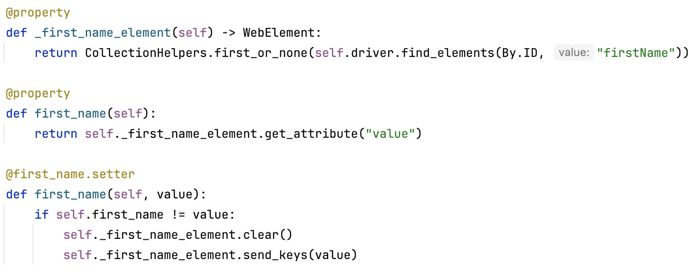
The Automagical Marvel
UI Element as a String
UI Element as a DateTime

Slide 12
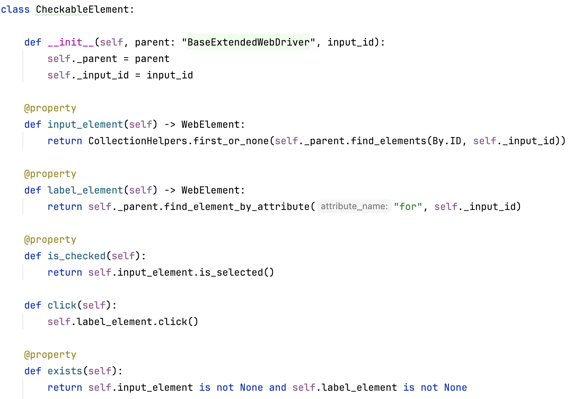
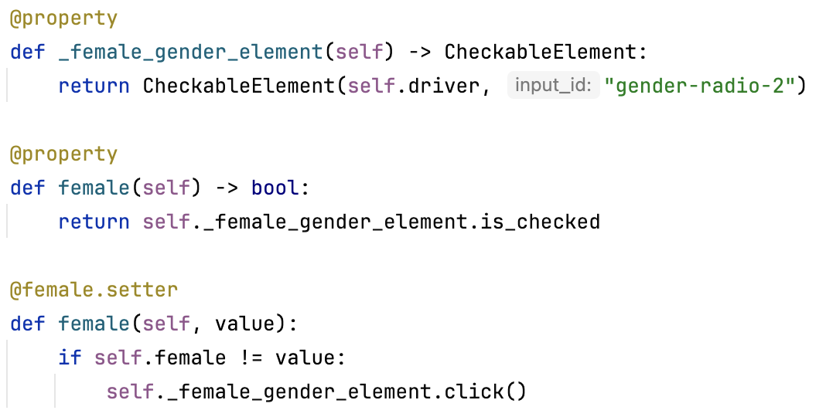
The Automagical Marvel
UI Element as a Boolean
Custom CheckableElement

Slide 13
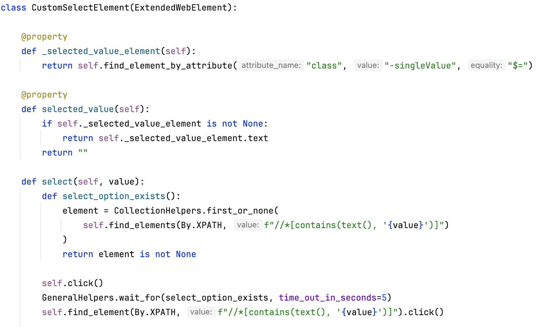
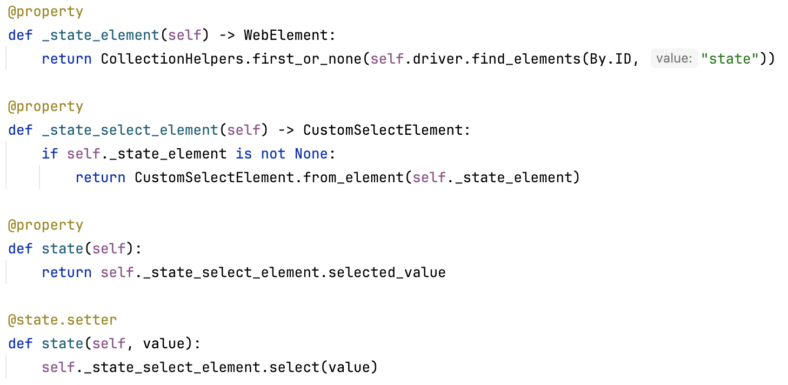
The Automagical Marvel
Select Element as String
Custom Select Element

Slide 14
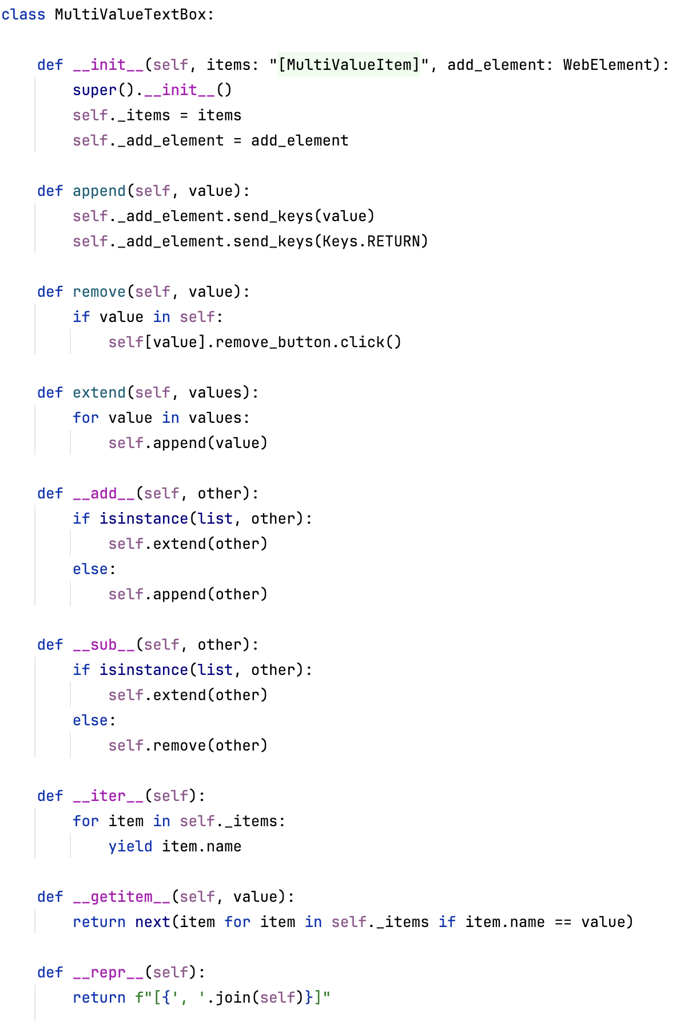
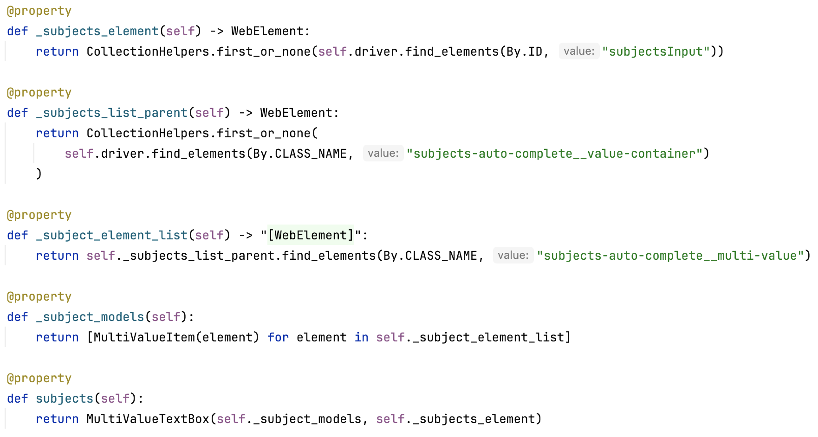
Multi-Value Textbox as a List of Strings

Slide 15
Let’s See It In Action!

Slide 16
Why Hybrid POM/LFM?
Benefits
Compatibility
Large initial cost but low maintenance cost
Easy to read, maintain and understand
Accessible framework for Developers at any skill level or specialization.
Fast and efficient
Any Object-Oriented Language
Python, Swift, C#, TypeScript, Java, JS, etc.
Any Element-based UI Automation Suite
Selenium, Appium, GameDriver
XCTest/XCUI, Microsoft UI, PyCocoa, etc.
Any Operating System
macOS, Linux, Windows, iOS/iPadOS, etc.

Slide 17

Meet The Artist
Sophia McKeever (She/Her)
10+ years as an SDET
Employers Include:
The Pokémon Company International
Apple Inc. – Apple Media Products (AMP)
Microsoft – Microsoft Azure
DataSphere Technologies Inc.
Digital Artist
Vintage Computing Enthusiast
Autistic

Slide 18

Clone the Code!
Experience the Magic behind the Hybrid POM/LFM Paradigm firsthand
Play, practice, learn!
Currently built in Python
More examples on the way!
GitHub: Snip3rM00n
Repo: pnsqc_quality_jam_demo
https://github.com/Snip3rM00n/pnsqc_quality_jam_demo

Slide 19
Thank you!
Enjoy the rest of Quality Jam!

